Slide 1
BSBME SENIOR DESIGN PROJECT
Patient-tailored orthotics treating Neurodegenerative and Trauma Injuries
Name: Stasia Mculsky
Advisor: James Wynne
Keywords: Orthotics, patient, materials

Slide 2
Abstract
There are many children suffering from neurodegenerative diseases, along with trauma, which then lead to other issues such as issues in the legs and feet that then need orthotics. These diseases include but are not limited to brachiosephali, scoliosis, spinibifida, multiple sclerosis, lyme disease, connective tissue disorder, cerebal palsy, trisomy 12. In addition to diseases, strokes, trauma and anything really leading to a loss of oxygen in the brain cause issues often in the leg and foot area, needing to be treated with orthotics. Orthotics are often thought to be preventative, but due to the fact that I will be working in pediatric orthotics, these braces can also be corrective. Orthotics that have to ability to decrease the negative effects of these diseases are greatly necessary to increase quality of life for these children and decrease the negative future possibilities if their diseases are left untreated. Orthotics are a non-invasive, non-surgical, topical means of gradually treating the issues that arise with these diseases. Current treatments involve physical therapy, chiropracters, and other methods. The long term goal for this project is to develop orthotics that treat the patient, i.e. reshape the head in the case of brachiosephaly or lessen the planter-flex of an ankle of a patient suffering from spinibifida. The proposed study will create several different types of orthotics, being helmets or AFOs that significantly decrease the effects of the given disease. I plan to test the success of my devices by utilizes the normal measurement ranges dictated by the charts attached at the end of this paper as well as durability of materials, and comfort of orthotic.

Slide 3
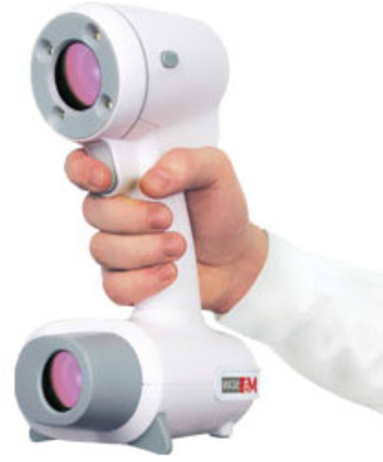
ELEMENTS OF ENGINEERING DESIGN
What was designed: patient-tailored orthotic helmet
Objectives set: create a patient specified helmet capable of reshaping a skull that is mis-shapen due to brachycephaly or plagiocephaly. This helmet is to be made of a durable, yet somewhat flexible material and should be comfortable to wear.
How basic science, math, and/or engineering sciences were applied: force balancing to reshape the skull, materials science to construct the orthotic of the correct material (i.e. durable but not stiff such as copolymer), anatomy (in order to be able to diagnose the patient properly and be able to treat specific diseases and lastly CAD was utilized to visualize the head shape after scanning it in to base the helmet off of
Scanning tool used
Taken from http://rodin4d.com/en/Products/acquisition/m4d-scan

Slide 4
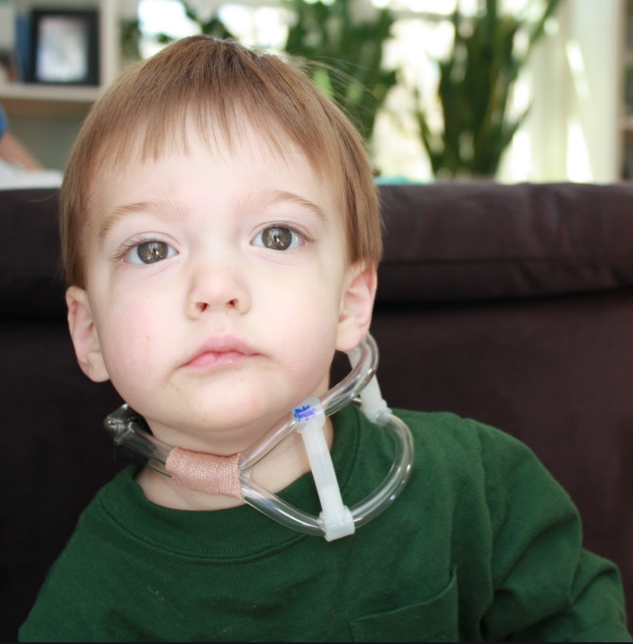
ELEMENTS OF ENGINEERING DESIGN
How the objectives were tested/evaluated: bi-weekly assessments of the patient’s skull with measurement checks in relation to the plagio/brachicephaly charts. If the measurements of certain cross-sections of the skull begin to decrease and become more symmetrical, the helmet is successful in treating these diseases.
Realistic constraints considered: cost, comfort, durability, weight of orthotic, design/aesthetic of product
Alternative solutions considered: different materials were looked into such as moleskin or foam for the inside of helmet, doc bands (less bulky but need to be cast), torticollis collar (very invasive)
The extent to which the final result met the set objectives: the results were very positive, asymmetry in the skull was decreased greatly and measurements went into the normal ranges according to brachycephaly charts
Torticollis collar
Taken from http://little-linus.blogspot.com/2011/03/name-that-tot-collar.html

Slide 5
Design Flow Chart
Take image of skull utilizing scanner
Clean image of extraneous data
Fit to patient and check for redness after few minutes of wear
Give to patient and check back in 2 weeks
Outer part of helmet cast utilizing scan
If any issues, go back into lab and adjust
Foam inserted in helmet
shave down helmet where skin is irritated
make sure measurements are decreasing and comfort is good (no irritation)

Slide 6
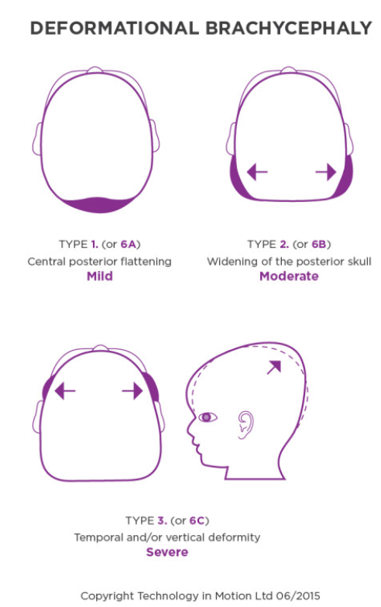
Introducton & proJect objective
-Brachycephaly = shortened front-to-back diameter of the skull
-Plagiocephaly = flattening of one side of the head, resulting in asymmetry and sometimes bulging of the forehead on the flat side of the skull.
-These are very common diseases in infants, quantified as about 1 in 5 babies.⁶
Current Objective: create a patient specificied helmet capable of reshaping a skull that is mishapen due to brachycephali or plagiocephaly. This helmet is to be made of a durable, yet somewhat flexible material and should be comfortable to wear (i.e. should not irritate skin, not too heavy)
Boston Prosthetics & Orthotics
Images of Brachycephalic skull

Slide 7
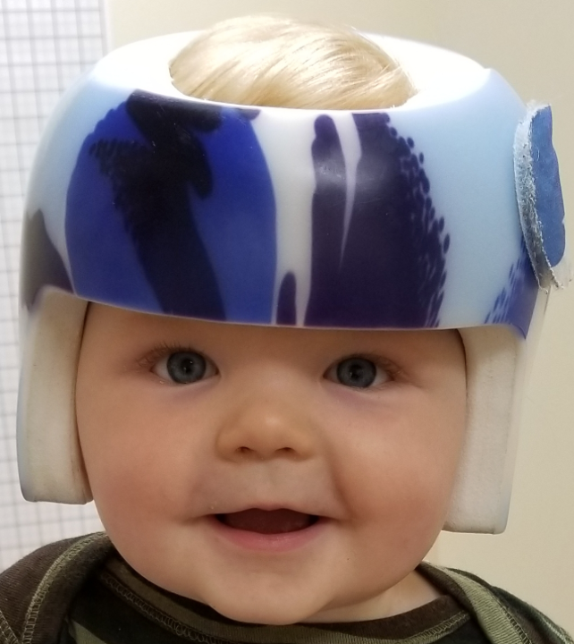
Method Specifications
-This treatment must be done while the infant is still young, i.e. typically around the age of 4 months is ideal.
-The reason early treatment is necessary is this is when the skull is still malleable and therefore this helmet can actually reshape the skull, i.e. corrective.
-Depending on the severity of the skull deformation, the time of wear will vary, but we can assume it will be anywhere from 20-23 hours a day.
Helmet design
Boston Prosthetics and Orthotics

Slide 8
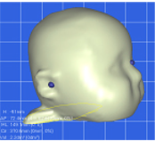
methods
-understand the diseases being treated in the clinic such as cephalic diseases -gain proficiency in the anatomy and diagnoses
-dissect current treatments
-utilize the scanner and clean the images in CAD
-create the mold
-cook and shape the polymer onto the mold
-apply a pressure force on the extruding section of skull while concaving the helmet to allow alleviation of pressure on the flatter sections of the skull, enabling room for growth using foam
-polymer study to try and find a material that does not crack as easily or deform over time
CAD/CAM scan of skull
Boston Orthotics and Prosthetics

Slide 9
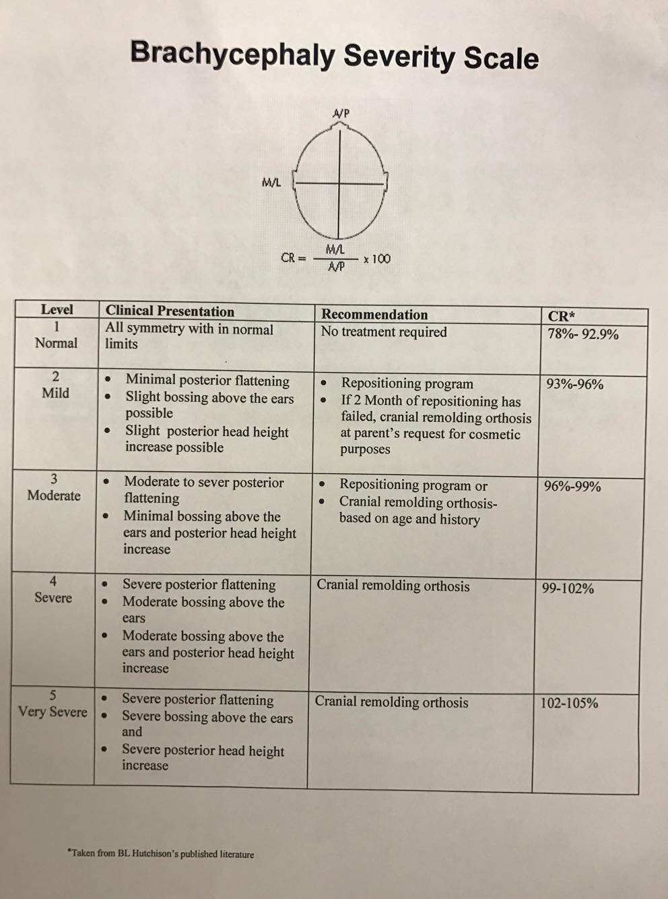
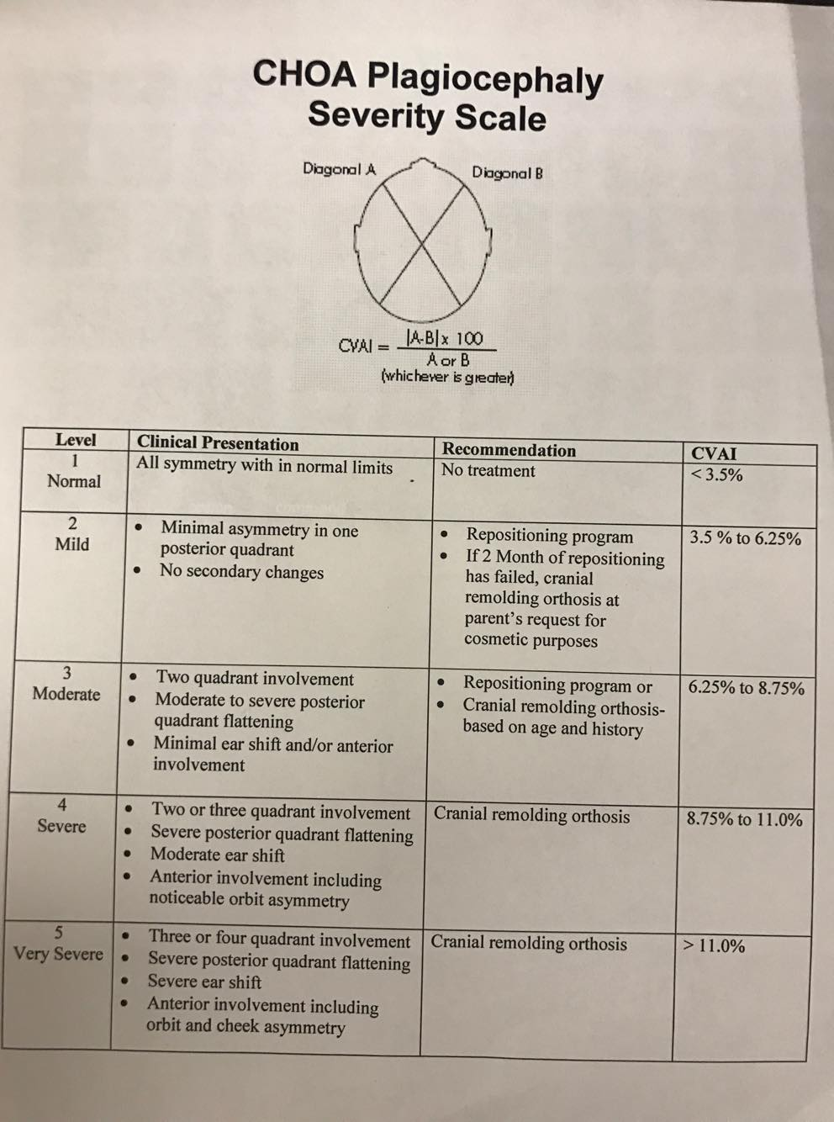
RESULTS
-Charts used to determine severity of Brachycephlay and Plagiocephaly
-CVAI= cranial vault assessment index
Both taken from BL Hutchinson’s published literature

Slide 10
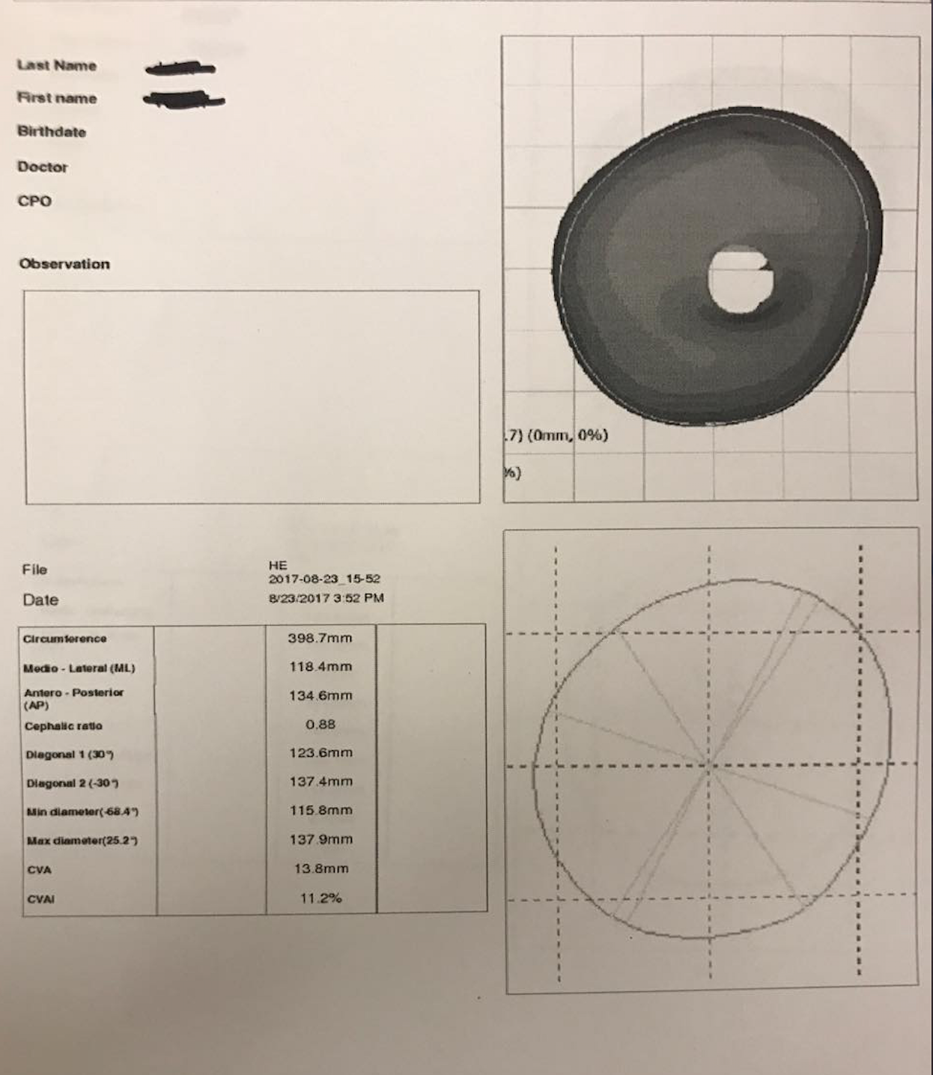
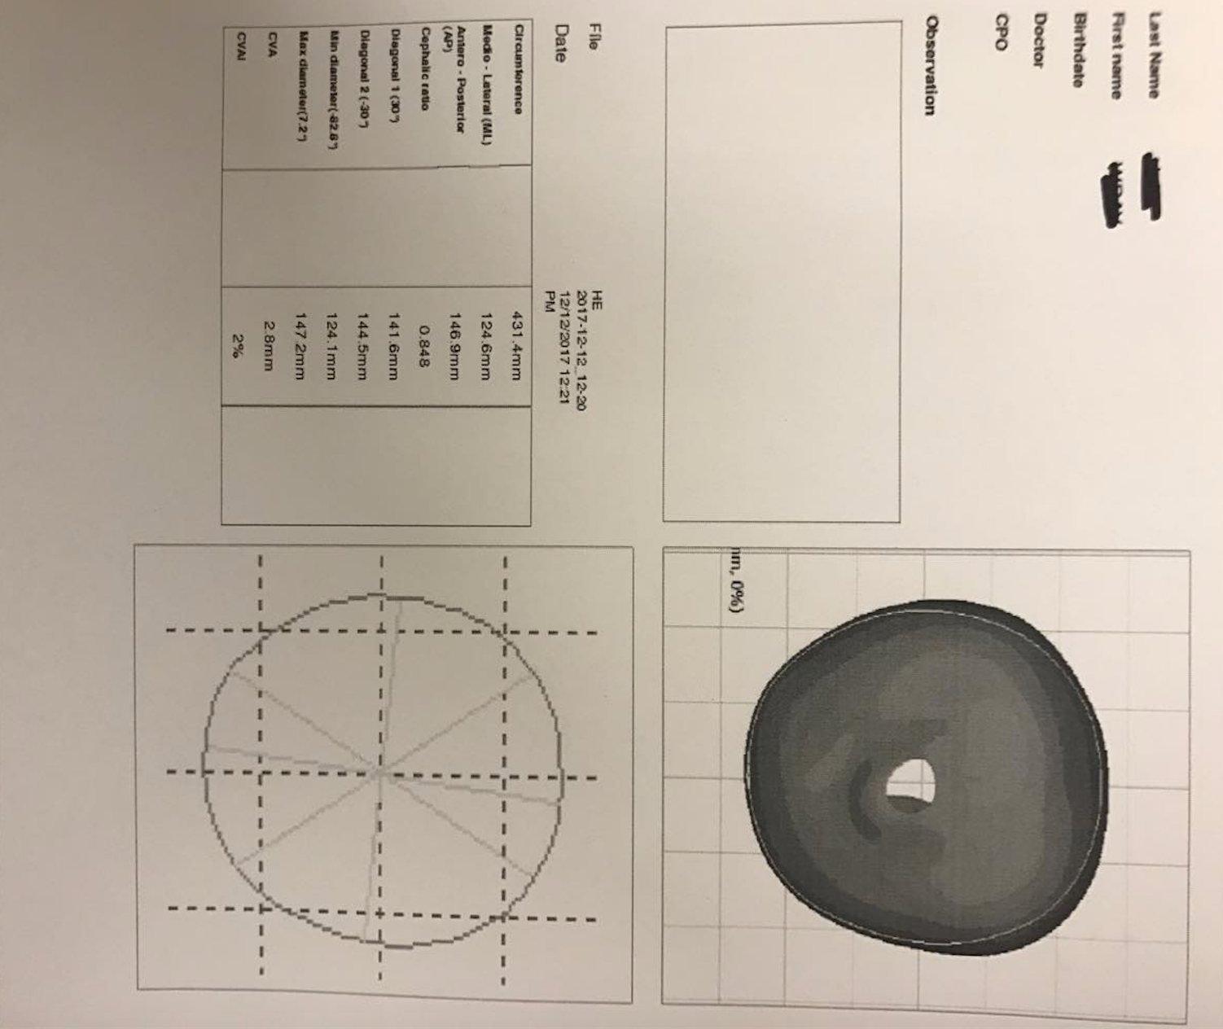
Results
-scans of patient over the span of 4 months
-suffers from plagiosephaly

Slide 11
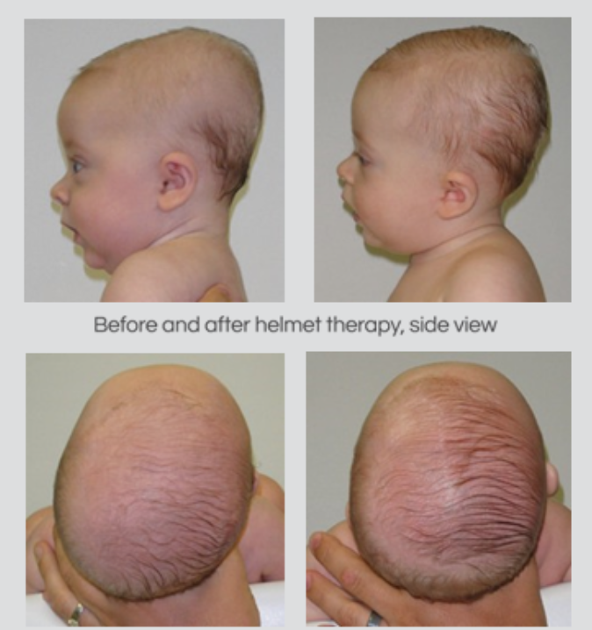
discussion
- The two charts used to quantify brachycephaly and plagiocephaly utilize anterior/posterior along with medial/lateral measurements
As the data shows, the cranial vault assessment index decreases into normal ranges after use of the helmet
Cranial ratio also decreases into normal ranges
Before and after use of helmet we designed
Boston Orthotics and Prosthetics

Slide 12
Discussion
Limitations:
-weight of product: ideally would like to make it lighter if possible
-ventilation: need the helmet to be more aerated while still maintaining structural stability
-skin irritation: in some patients, the helmet is causing rashes
-aesthetic: may parents of the infants with the helmet dislike the look as it separates their child from the normative look

Slide 13
Discussion
How we address limitations in the future:
-weight: I want to look into more lightweight polymers that can still maintain structural integrity/don’t wear over time or lose shape/safe to be in contact with skin
-ventilation: an easy fix is more wholes in the helmet but I want to explore maybe a hardened mesh material with more aeration
-skin irritation: I have partially explored the option of lining the helmet with moleskin but also want to explore hydrogels of some sort that do no stick to the hair but gives a less irritating material to interact with
-aesthetic: I want to somehow maintain the force balances everywhere but decrease the bulk and obviousness of the design, maybe to the point where it can look more like a beanie than a helmet

Slide 14
Conclusions
-In summation, I made several helmets treating plagiocephaly and brachiocephaly in infants that were very successful in reducing asymmetry in the skull and reducing the width of the skull over the course of several months.
-I also conducted a little bit of materials research in attempting to make orthotics of different materials such of polyethelene.
-Lastly, I explored several options for the interior of the helmet to reduce irritation such as moleskin.
-I expect to continue my search into how to better the orthotics that I built by attempting to reduce weight, increase ventilation, decrease irritation to name a few.

Slide 15
Timeline & Future Tasks
September
Literature review on doc bands/other less bulky options, materials study
October
Incorporate more materials into design and build smaller helmets
November
Conduct trials on success, comfort and validation tests
December
Get patient feedback, cost assessments
Future Tasks
-downsize bulkiness and weight of helmet
-integrate different materials into helmet mold
-decrease irritation of helmet

Slide 16
Acknowledgements
Thank you to James Wynne, Brad Varney, Stephen Beaudoin, David Benedict CTPO for all the guidance in the lab, taking time out of your work days to teach me all about the world of orthotics.

Slide 17
References
“Cephalic Disorders Fact Sheet.” National Institute of Neurological Disorders and Stroke, U.S. Department of Health and Human Services, www.ninds.nih.gov/Disorders/Patient-Caregiver-Education/Fact-Sheets/Cephalic-Disorders-Fact-Sheet.
Gianotti, Raffaele, et al. “Benign Cephalic Histiocytosis.” The American Journal of Dermatopathology, vol. 15, no. 4, 1993, pp. 315–319., doi:10.1097/00000372-199308000-00004.
Kluba, S., Kraut, W., Calgeer, B., Reinert, S., & Krimmel, M. (2014). Treatment of positional plagiocephaly – Helmet or no helmet? Journal of Cranio-Maxillofacial Surgery, 42(5), 683-688. doi:10.1016/j.jcms.2013.09.015
Marín-Padilla, Miguel. “Cephalic Axial Skeletal-Neural Dysraphic Disorders: Embryology and Pathology.” Canadian Journal of Neurological Sciences / Journal Canadien Des Sciences Neurologiques, vol. 18, no. 02, 1991, pp. 153–169., doi:10.1017/s0317167100031632.
NHS Choices, NHS, www.nhs.uk/conditions/plagiocephaly-brachycephaly/.
Parsons, F. G. “The Brachycephalic Skull.” The Journal of the Royal Anthropological Institute of Great Britain and Ireland, vol. 54, 1924, p. 166., doi:10.2307/2843666.
“Plagiocephaly Helmets.” Technology In Motion, www.technologyinmotion.com/plagiocephaly-helmets/.
Sestokas, L., Rawlani, R., Rawlani, V., Connor, C., & Vicari, F. (2012). Treatment Efficacy of Deformational Plagiocephaly and Brachiocephaly. Plastic and Reconstructive Surgery, 130, 17. doi:10.1097/01.prs.0000421717.28128.4b

